Slide 1
The Unix Shell
Presented By:
Mahabuba Sharmin Muna
ID:2016-1-60-032
Md. Hafanul Islam
ID:2016-3-60-004

Slide 2
Introduction
A shell is a program that is an interface between a user and the raw operating system.
UNIX shell scripts are text files that contain sequences of UNIX commands

Slide 3
Like high-level source files, a programmer creates shell scripts with a text editor
Shell scripts do not have to be converted into machine language by a compiler
This is because the UNIX shell acts as an interpreter when reading script files

Slide 4
Description
There are four common shells in use:
the Bourne shell
the Korn shell
the C shell
the Bash shell (Bourne Again Shell)

Slide 5
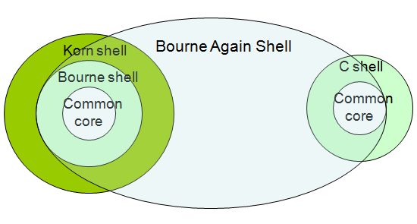
Relationship between the four Shells

Slide 6
Here I introduce with some command-
ls
cd
mv
man
locate
mkdir
kill
killall
clear

Slide 7
Conclusion
The shell supports numerous operators, including many for performing arithmetic operations
The logic structures supported by the shell are sequential, decision, looping, and case

